Slide 1

Predicting customer buying behaviour
By: Ece Yavuzyılmaz
29/04/2023

Slide 2
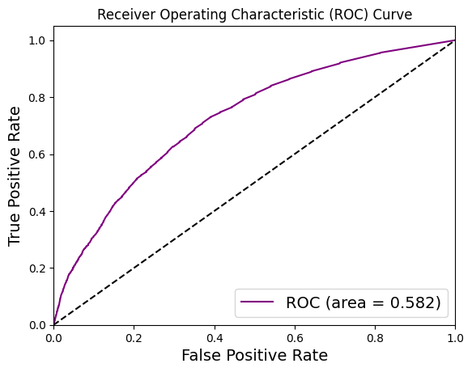
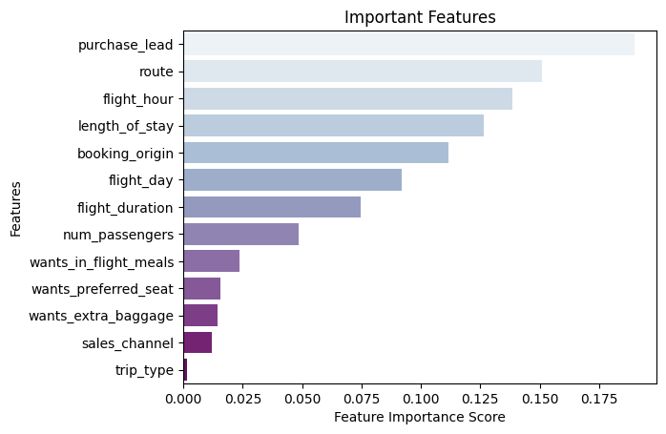
predictive model to understand factors that influence buying behaviour
We have trained the data set with ‘Random Forest Classifier Model’ and received,
Model accuracy score with 100 decision-trees : 0.8371
AUC score: 0.582 (AUC score should be increased)
And our top 5 most important factors that affect customer bookings:
Purchase_lead
Route
Flight_hour
Length_of_stay
Booking_origin

